Slide 1
Case Study:
Beer and Breweries of the United State
Team Data Junkies
Chris Roche, Puri Rudick, Ryan Kinney

Slide 2
Agenda
Brewery locations across the country
Summary of Alcohol By Volume (ABV) and International Bitterness Units (IBU)
Relationship between ABV and DUI (Driving Under the Influence) Arrests
Summary of beer container size and our recommendation

Slide 3
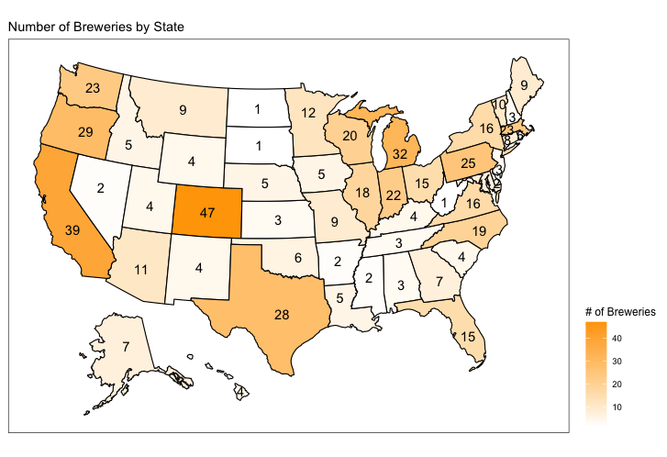
Breweries of the United States
Quick Facts:
Colorado has the most breweries with 47
West Virginia, North Dakota, and South Dakota each have one brewery
Missouri (the home of Anheuser-Busch & Budweiser) has 9 breweries
Ranks 20th

Slide 4
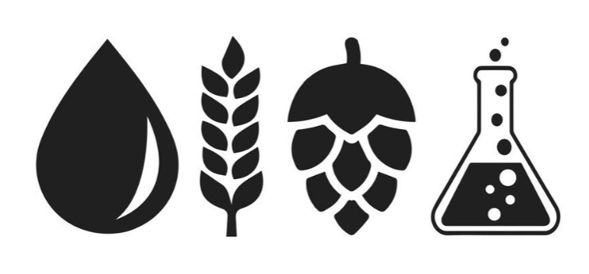
Missing Values in the Dataset
A summary of the missing data in the beer dataset:
ABV has 62 missing values,
IBU has 1005 missing values, and
Style has 5 missing values
All South Dakota beers are missing IBU value
Team Data Junkies filtered observations with missing values out of the dataset before performing exploratory data analysis

Slide 5
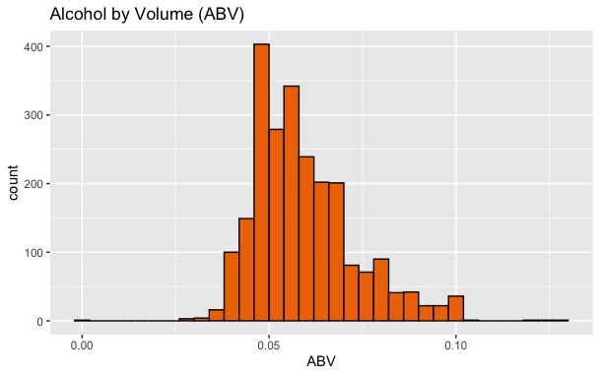
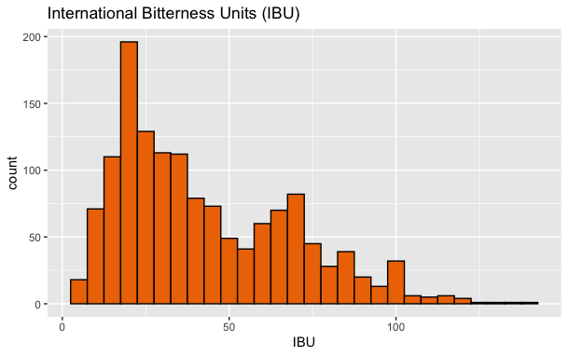
Alcohol By Volume (ABV) and International Bitterness Units (IBU)
ABV’s in the dataset range from a minimum of 0.1% to a maximum of 12.8%
The average ABV is 6% with a standard deviation of 1.4%
IBU’s in the dataset range from 4 to 138
The average IBU is 43 with a standard deviation of 26

Slide 6
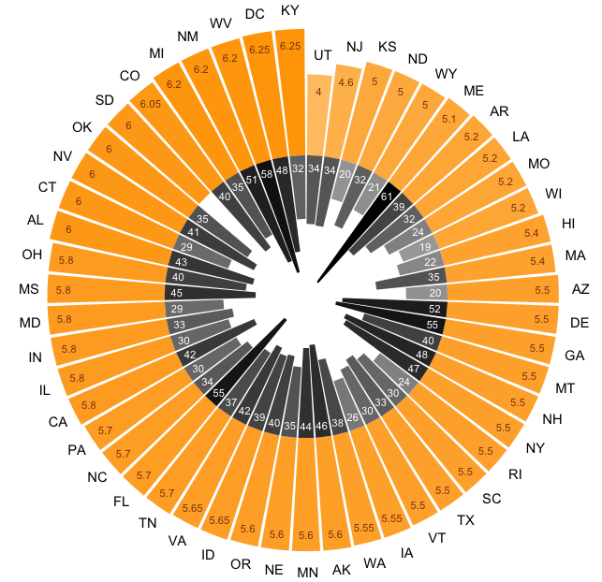
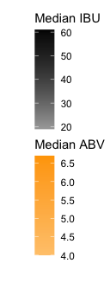
The Most Alcoholic and Bitter Beers in the United States
On average:
Colorado and Kentucky has the most alcoholic (6.25%)
Maine has the most bitter beer (61 IBU)
By individual beers:
Colorado has the highest ABV beer at 12.8%
Lee Hill Series Vol. 5 by Upslope Brewing Company
Oregon has the most bitter beer at an IBU of 138
Bitter B**** Imperial IPA by Astoria Brewing Company
* The bar chart ordered clockwise by median ABV value
** The darker color represents higher value of median ABV and IBU

Slide 7
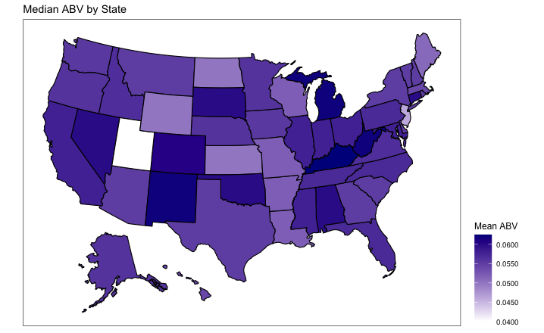
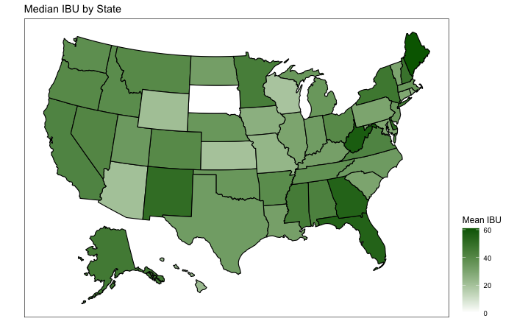
Regional Distributions of ABV and IBU
There are no clearly defined patterns to suggest any one region of the United States prefers more bitter (higher IBU) or stronger (higher ABV) beer.
Utah and Arkansas had laws until 2020 limiting the alcohol content of beer.
Recall South Dakota has a lack of IBU data.

Slide 8
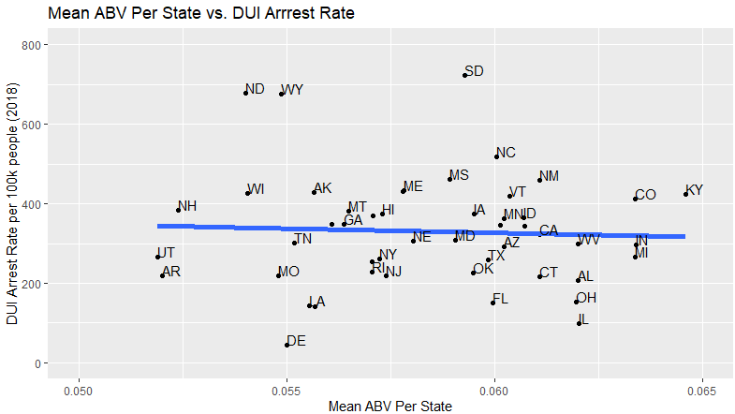
Relationship Between ABV and DUI Arrests
Almost zero correlation between the mean ABV and DUI arrest rates per state.
Importance: Budweiser does not need to worry about where to incorporate future beers that have higher ABV’s.
DUI data pulled from backgroundchecks.org

Slide 9
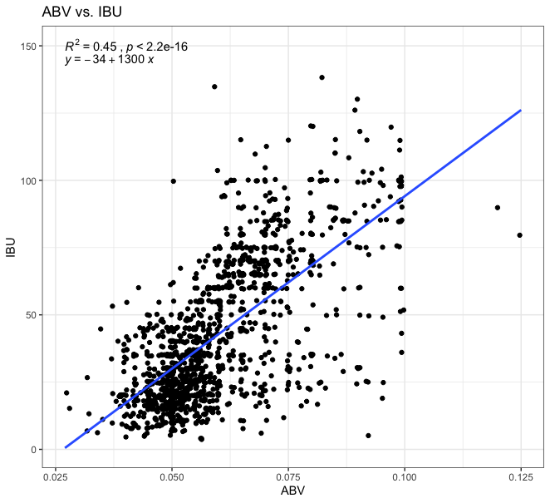
The Relationship Between ABV and IBU
A scatterplot was created to plot the relationship between ABV and IBU.
There is a positive relationship, suggesting that as IBU rises so to does ABV.

Slide 10
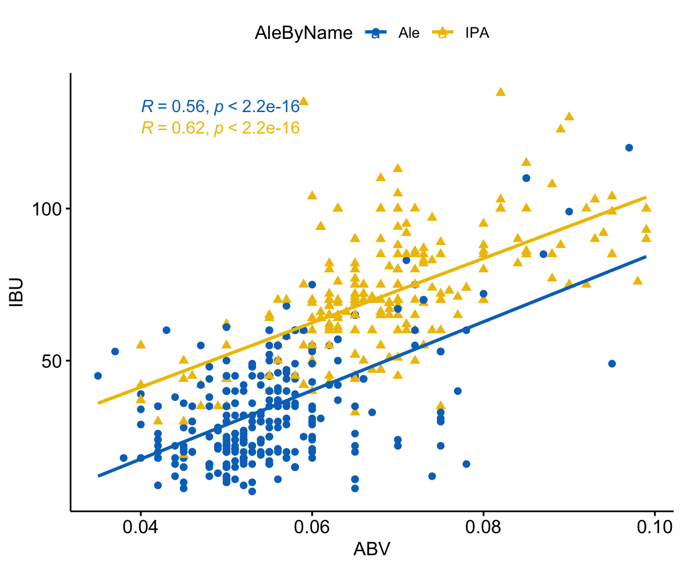
ABV and IBU between IPAs and Other Types of Ale
Both IPAs and other types of Ale have positive relationship between ABV and IBU
At the same alcohol content (ABV), IPAs trend to be more bitter than other types of Ale

Slide 11
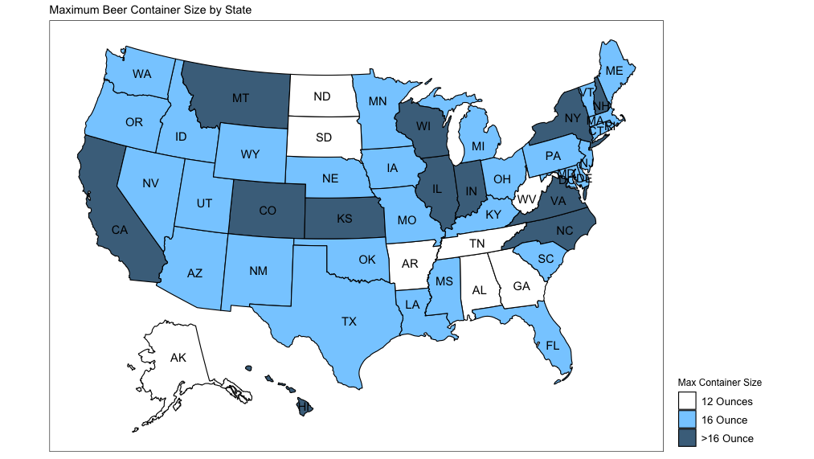
Maximum Beer Container Size by State
There are 9 states that the biggest beer container size is only 12 ounces
Alaska, Alabama, Arkansas, DC, Georgia, North Dakota, South Dakota, Tennessee, and West Virginia
Good opportunity for Budweiser to launch a bigger size product

Slide 12
Backup

Slide 13
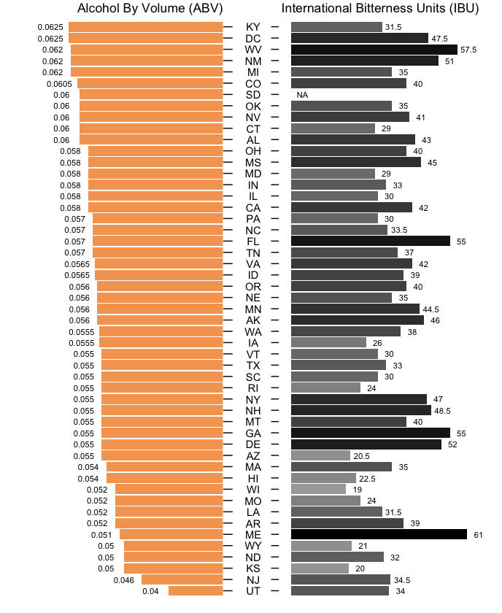
Alcohol By Volume (ABV)
and International Bitterness Units (IBU) for Each State

Slide 14
The Relationship Between ABV and IBU
 | Estimate | Std. Error | T value | P value
IBU (intercept) | -34.068 | 2.327 | -14.64 | < .0001
ABV | 1281.861 | 37.871 | 33.85 | < .0001
95% CI Slope = (1207.57, 1356.15)
95% CI Intercept = (-38.63, -29.50)

Slide 15
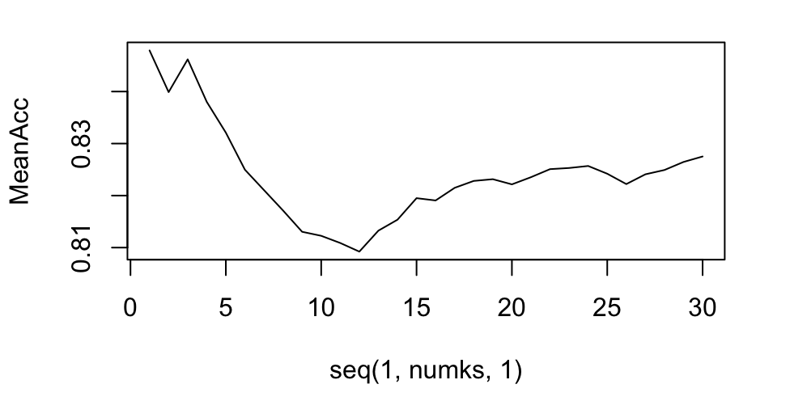
KNN Classification for ABV and IBU between IPAs and Ale
k = 3 gives the highest percent of accuracy, which is ~86%
 | k = 3 | k = 5 | k = 7
Accuracy | 86% | 82% | 82%
Sensitivity | 90% | 86% | 81%
Specificity | 81% | 78% | 83%

Slide 16
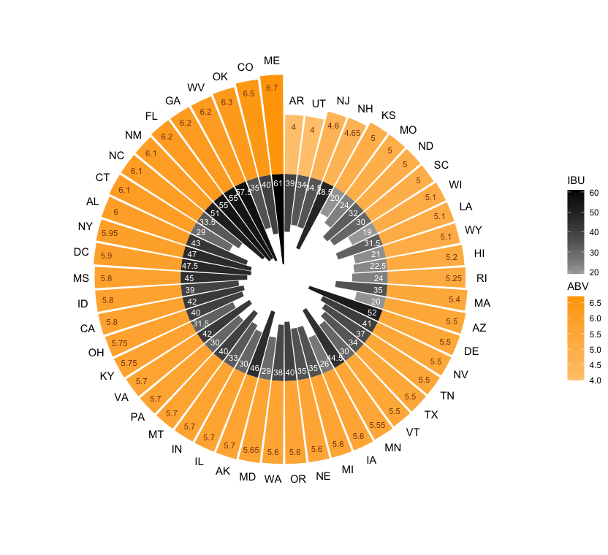
Alcohol By Volume (ABV) and International Bitterness Units (IBU) for Each State
ABV’s in the dataset range from a minimum of 2.7% to a maximum of 12.5%
The average ABV is 6% with a standard deviation of 1.3%
IBU’s in the dataset range from 4 to 138
The average IBU is 43 with a standard deviation of 26
* The bar chart ordered clockwise by median ABV value
** The darker color represents higher value of median ABV and IBU

Slide 17
The Most Alcoholic and Bitter Beers in the United States
On average:
Colorado and Kentucky has the most alcoholic (6.25%)
Maine has the most bitter beer (61 IBU)
By individual beers:
Colorado has the highest ABV beer at 12.8%
Lee Hill Series Vol. 5 by Upslope Brewing Company
Oregon has the most bitter beer at an IBU of 138
Bitter B**** Imperial IPA by Astoria Brewing Company

